Slide 1


Selenium WebDriver
Software Quality Assurance
Telerik Software Academy
http://academy.telerik.com

Slide 2




The Lector
Anton Angelov
QA Architect Licensing Team
@angelovstanton
Site: http://automatetheplanet.com

Slide 3

Table of Contents
Selenium WebDriver
Element Locators
Custom Format
Page Object Model
Selenium Grid

Slide 4

Brief History of The Selenium

Slide 5
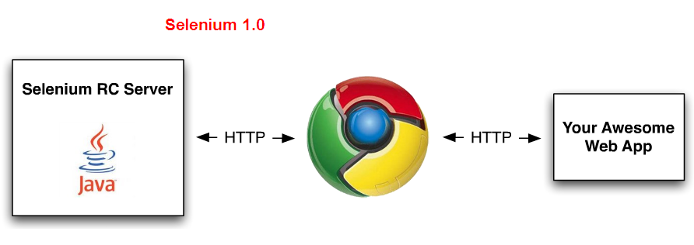
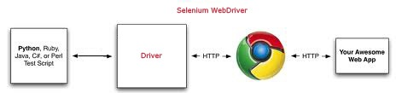
Selenium RC vs. WebDriver
Selenium-RC "injected" JS functions into the browser when the browser was loaded and then used its JS to drive the AUT within the browser
Selenium-WebDriver makes direct calls to the browser using each browser’s native support for automation

Slide 6

Why Selenium and WebDriver are being merged
Positive points
Works with any browser that supports JavaScript
More life-like interaction with the browser
Not bound by the JavaScript sandbox
Large Communities
Support Many Program Languages

Slide 7

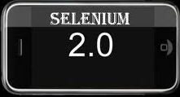
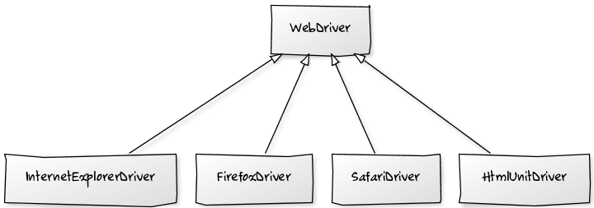
Selenium WebDriver

Slide 8

Why Use the WebDriver?
Selenium WebDriver
A tool for automating web application testing
Developed to better support dynamic web pages where elements of a page may change without the page itself being reloaded(AJAX)
Makes direct calls to the browser using each browser’s native support for automation the page itself being reloaded.

Slide 9
Selenium 1.0 + WebDriver = Selenium 2.0
Binding Code
(C#, Java …)
WebDriver Wire Protocol
Drivers
(IE, Firefox, Chrome …)

Slide 10
The WebDriver Wire Protocol
All implementations of WebDriver that communicate with the browser, or a Remote WebDriver server shall use a common wire protocol
The wire protocol defines a RESTful web service using JSON over HTTP
implemented in request/response pairs of "commands" and "responses“
Full Documentation: https://code.google.com/p/selenium/wiki/JsonWireProtocol#Actual_Capabilities

Slide 11
JSON Selenium REST API
POST Request
URL: http://localhost:64649/session
BODY:
{
"desiredCapabilities": {
"browserName": "chrome",
"chrome.switches": [ ],
"chromeOptions": {
"args": [ ],
"extensions": [ ]
},
"javascriptEnabled": true,
"platform": "WINDOWS",
"version": ""
}
}

Slide 12
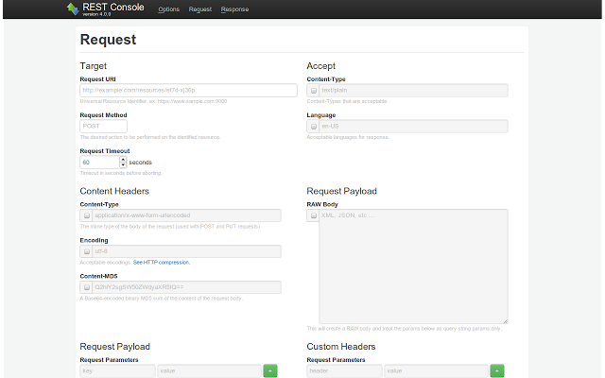
Rest Console Demo

Slide 13
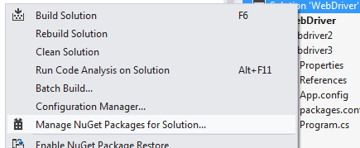
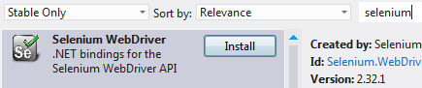
Setting Up WebDriver
Using NuGet packages
Create New Project in VS
Install NuGet package manager and navigate to it
Search for selenium and install the first item in the result list

Slide 14
Creating Driver
Create an instance of a driver
Note: additional steps are required to use Chrome Driver, Opera Driver, Android Driver and iPhone Driver
IWebDriver driverOne = new FirefoxDriver();
IWebDriver driverTwo = new InternetExlorerDriver();
Navigate to page
driver.Url = "http://www.google.com";

Slide 15
Getting Started
Choose and download browser driver you want to use for your tests (ex. Chrome)
The IWebDriver interface can be find under OpenQA.Selenium namespace
using OpenQA.Selenium;
using OpenQA.Selenium.Chrome;
namespace WebDriverDemo
{
class Program
{
static void Main(string[] args)
{
IWebDriver driver = new ChromeDriver(@"C:\libraries");
driver.Url= "http://www.google.com";
}
}
}
You have to tell the WebDriver API where this ChromeDriverServer is located
Notes:
http://code.google.com/p/selenium/downloads/list

Slide 16

Element Locators

Slide 17
Locating Elements
Elements can be located by the same properties as in the IDE
By ID
IWebElement element = driver.FindElement(By.Id("coolestWidgetEvah"));
By Class
IList<IWebElement> cheeses = driver.FindElements(By.ClassName("cheese"));
By Tag Name
IWebElement frame = driver.FindElement(By.TagName("iframe"));

Slide 18
Locating Elements(2)
By Name
IWebElement cheese = driver.FindElement(By.Name("cheese"));
By Link Text
IWebElement cheese = driver.FindElement(By.LinkText("cheese"));
By XPath
IList<IWebElement> inputs = driver.FindElements(By.XPath("//input"));
By CSS Selector
IWebElement cheese = driver.FindElement(By.CssSelector("#food span.dairy.aged"));

Slide 19
Locating Elements(3)
Chain of locators
IWebElement cheese = this.driver.
FindElement(By.ClassName(“firstElementTable")).
FindElement(By.Id(“secondElement"));
XPath Support
Try to use native XPath support of browsers. On those that don’t have, WebDriver provided its own implementation
Driver | Tag and Attribute | Native XPath Support
Internet Explorer Driver | Lower-cases | No
Firefox Driver | Case insensitive | Yes
Chrome Driver | Case insensitive | Yes

Slide 20
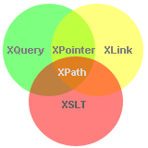
XPath Syntax
What is XPath?
XPath is a syntax for defining parts of an XML document
XPath uses path expressions to navigate in XML documents
XPath contains a library of standard functions
XPath is a major element in XSLT
XPath is a W3C recommendation

Slide 21
XPath Syntax(2)
XPath Expressions
<?xml version="1.0" encoding="UTF-8"?> <bookstore> <book> <title lang="en">Harry Potter</title> <price>29.99</price> </book> <book> <title lang="en">Learning XML</title> <price>39.95</price> </book> </bookstore>
Driver | Tag and Attribute
bookstore | /bookstore/book[last()]
/bookstore | /bookstore/book[last()-1]
bookstore/book | /bookstore/book[position()<3]
//book | //title[@lang]
bookstore//book | //title[@lang='en']
//@lang | /bookstore/book[price>35.00]
/bookstore/book[1] | /bookstore/book[price>35.00]/title
//book/title | //book/price | /bookstore/*
//* | //title | //price
Documentation: http://www.w3schools.com/xpath/xpath_syntax.asp

Slide 22
XPath Axes
Location Path Expression
axisname::nodetest[predicate]
//td[@id=‘elementId’]/following-sibling::td[1]
AxisName | Expression
ancestor | Selects all ancestors (parent, grandparent, etc.)
descendant | Selects all descendants (children, grandchildren, etc.)
following-sibling | Selects all siblings after the current node
preceding-sibling | Selects all siblings before the current node
child | Selects all children of the current node
parent | Selects the parent of the current node
attribute | Selects all attributes of the current node
Documentation: http://www.w3schools.com/xpath/xpath_axes.asp

Slide 23

XPath Locators Demo

Slide 24
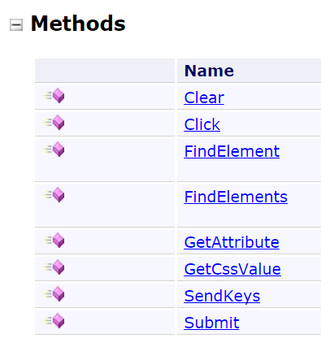
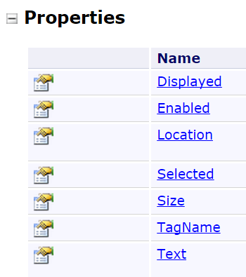
Hint: C# Documentation http://selenium.googlecode.com/git/docs/api/dotnet/index.html
IWebElement Members

Slide 25
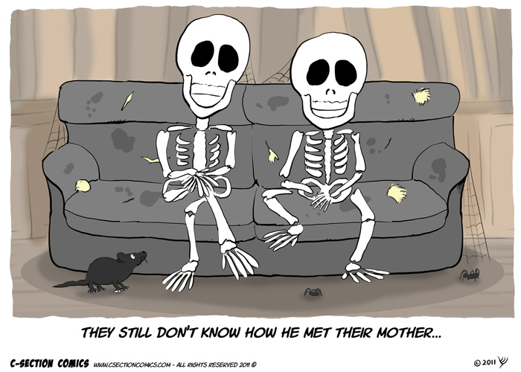
Wait Steps

Slide 26
Wait Steps
Explicit wait
WebDriverWait wait =
new WebDriverWait(driver, TimeSpan.FromSeconds(10));
IWebElement myDynamicElement =
wait.Until<IWebElement>(
(d) =>
{ return d.FindElement(By.Id("someDynamicElement")); }
);
Implicit wait
driver.Manage().Timeouts().
ImplicitlyWait(TimeSpan.FromSeconds(10));

Slide 27

Implicit vs Explicit Wait
Implicit Wait – assert action executed in exact interval (Performance Testing)
Explicit Wait – use it for dynamic pages where you don’t cate about the execution time (Functional Testing)
Thread.Sleep() – don’t use it!

Slide 28

Type Text
Type Text into a field using Selenium WebDriver SendKeys() function
IWebElement element = driver.FindElement(By.Name("search"));
element.SendKeys("telerik");

Slide 29
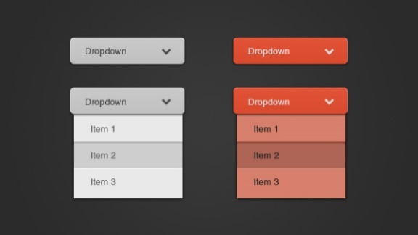
Select DropDown Value
<select>
<option value="volvo">Volvo</option>
<option value="saab">Saab</option>
<option value="mercedes">Mercedes</option>
<option value="audi">Audi</option>
</select>
SelectElement selectElement = new SelectElement(driver.FindElement(By.XPath("/html/body/select")));
selectElement.SelectByText("Saab");
Hint: Install NuGet Package - Selenium.Support

Slide 30

What are you doing Saturday Overtime?

Slide 31
Verify Text Steps
WebDriver does not support the well-known commands of Selenium IDE like verifyTextPresent
We can implement so
public static void AssertTextPresent(String value)
{
if (!driver.PageSource.Contains(value))
{
throw new Exception(value + " is not present");
}
}

Slide 32
Asserts
There wasn’t any built-in method to assert text on a page
You can do something along the lines of
static void Main(string[] args)
{
IWebDriver driver = new ChromeDriver(@"C:\libraries");
driver.Url= "http://www.google.com";
Assert.AreEqual("Google", driver.Title);
}

Slide 33
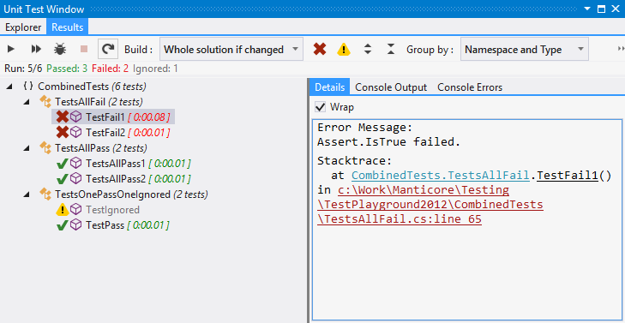
Reporting Results
The test results are limited by the Unit Testing Framework we use
ex. NUnit, MSTest, Gallio

Slide 34
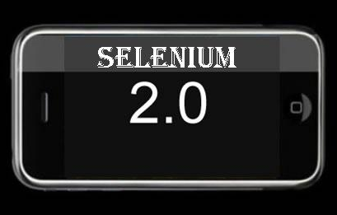
WebDriver Demo

Slide 35
C# Formatters
Plugins for Selenium IDE
add WebDriver backed Selenium formatters
allows users to take advantage of WebDriver without having to modify their tests
https://addons.mozilla.org/en-US/firefox/addon/webdriver-backed-formatters/

Slide 36
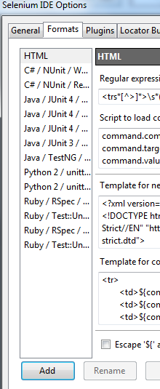
Custom Format
You can add any format you like by writing JavaScript code
Open Options dialog ->"Options…" in the menu bar -> "Formats" tab
Create a new format by clicking "Add" button
There are 3 empty functions
parse
format
formatCommands

Slide 37
Custom Format (2)
The "parse" function is almost opposite of "format". This function parses the String and updates test case
function parse(testCase, source) {
var doc = source;
var commands = [];
while (doc.length > 0) {
var line = /(.*)(\r\n|[\r\n])?/.exec(doc);
var array = line[1].split(/,/);
if (array.length >= 3) {
var command = new Command();
command.command = array[0]; command.target = array[1];
command.value = array[2]; commands.push(command);
}
doc = doc.substr(line[0].length);
}
testCase.setCommands(commands);
}

Slide 38
Custom Format (3)
The "formatCommands" function is similar to "format" function, but is used to copy part of the test case into the clipboard
function formatCommands(commands) {
var result = '';
for (var i = 0; i < commands.length; i++) {
var command = commands[i];
if (command.type == 'command') {
result += command.command + ',' + command.target + ',' + command.value + "\n";
}
}
return result;
}
'ext.Driver.Navigate().GoToUrl("' + command.target.toString() + '");';

Slide 39
Custom Format (4)
The "format" function creates an array of commands contains command object (Command, Target, Value)
function format(testCase, name) {
var result = '';
var commands = testCase.commands;
for (var i = 0; i < commands.length; i++) {
var command = commands[i];
if (command.type == 'command') {
result += command.command + ',' + command.target + ',' + command.value + "\n";
}
}
return result;
}
return formatCommands(testCase.commands);

Slide 40

C# Formatters Demo

Slide 41
Refactoring for Page Object Model
The PageFactory class is an extension to the PageObject design pattern
Install Selenium WebDriver Support Classes package
private IWebDriver driver;
[FindsBy(How = How.Id, Using = "SearchTerm")]
private IWebElement Search; // How.Id = SearchTerm
[FindsBy(How = How.Id, Using = "SearchButton")]
private IWebElement Button;
public FindUsersPage Do(string UserName)
{
Search.SendKeys(UserName);
Button.Click();
PageFactory.InitElements(driver, (new FindUsersPage(this.driver)));
return new FindUsersPage(driver);
}
FindUsersPage PageObject must be created
The InitElements method of PageFactory initializes the elements of the PageObject

Slide 42

Page Object Model Demo

Slide 43

Phantom JS
PhantomJS is a headless WebKit scriptable with a JavaScript API
It has fast and native support for various web standards:
DOM handling, CSS selector, JSON, Canvas, and SVG
Download from http://phantomjs.org/download.html

Slide 44

Selenium Grid

Slide 45
Selenium-Grid
Selenium-Grid allows you run your tests on different machines against different browsers in parallel
Selenium
Test
Hub
Node
Node
Node
Drivers
Drivers
Drivers

Slide 46
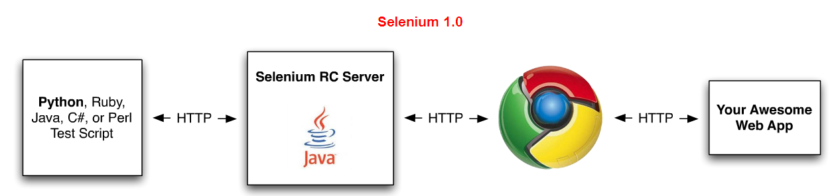
Selenium Server
The Selenium Server
Launches and kills browsers
Interprets and runs the Selenese commands passed from the test program
Acts as an HTTP proxy, intercepting and verifying HTTP messages passed between the browser and the AUT

Slide 47
Selenium Server
Selenium Server
Receives Selenium commands from the test program
Interprets them
Reports back to your program the results of running those tests
Bundles Selenium Core and automatically injects it into the browser
When the test program opens the browser

Slide 48
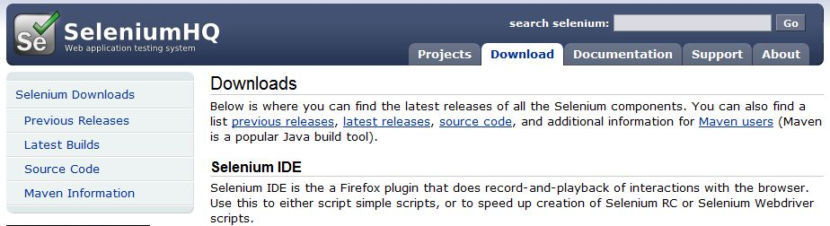
Download Selenium Server
Selenium Server can be downloaded from:
http://seleniumhq.org/download/

Slide 49


Installing Selenium Server
The Selenium RC server is simply a Java jar file (selenium-server.jar)
Doesn’t require any special installation
Just download the zip file and extract the server in the desired directory

Slide 50

Running Selenium Server
Running Selenium Server requires Java Development Kit (JDK) to be installed on your machine and included in the class path
http://www.oracle.com/technetwork/java/javase/downloads/index.html
Use CMD
Navigate to the directory where Selenium RC’s server is located and run the following from a command-line console:
java -jar selenium-server.jar

Slide 51
Setup Selenium-Grid
Step 1: Start the hub
java -jar selenium-server-standalone-2.14.0.jar -role hub
Step 2: Start the nodes
java -jar selenium-server-standalone-2.14.0.jar -role node -hub http://localhost:4444/grid/register
Using grid to run tests
DesiredCapabilities capability = DesiredCapabilities.Firefox();
Driver = new RemoteWebDriver(new Uri("http://localhost:4444/wd/hub"), capability);
Hint: Open Grid Console from http://localhost:4444/grid/console

Slide 52

Selenium Grid Demo

Slide 53

Automate Custom Controls

Slide 54

Why to Automate?

Slide 55

Why to Automate?
1. Regression

Slide 56

Why to Automate?(2)
2. System Level Testing
Testing like the real user

Slide 57

Why to Automate?(3)
3. Combinatorial Testing

Slide 58
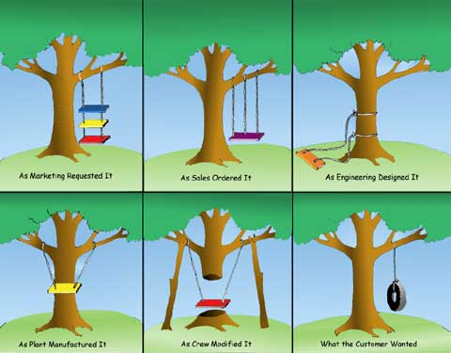
Why to Automate?(4)
4. Exact Requirements

Slide 59


Why NOT to Automate?(5)

Slide 60
Selenium WebDriver
?
?
?
?
?
Questions?
?
?
?
?
?
?

Slide 61
Exercises
Create Automated Selenium WebDriver Test for
Log in in http://www.stage.telerikacademy.com/. Use appropriate validations to create a good test
Go to “Settings” and fill in all the fields with information about yourself
Save changes and verity that updated information is shown on your profile page
Test if the validation of the input fields works properly. Think of an appropriate way to organize your validation tests
Think how to log test errors
Use Base test class with methods missing in WebDriver
Try To Use Page Object Model in your test

Slide 62




Free Trainings @ Telerik Academy
C# Programming @ Telerik Academy
csharpfundamentals.telerik.com
Telerik Software Academy
academy.telerik.com
Telerik Academy @ Facebook
facebook.com/TelerikAcademy
Telerik Software Academy Forums
forums.academy.telerik.com

